Slide 1
IoT Applications Week 4
Wednesday

Slide 2
Agenda
Sampling & Sampling Theorem (resume from previous lecture)

Slide 3
Sampling
Up-Sampling
A.k.a. Extrapolation
Down-Sampling (subsampling)
A.k.a. Interpolation
Matlab Code
SamplingDemo_Incomplete.m

Slide 4


Sampling
Why does a lower resolution image still make sense to us? What do we lose?
Image: http://www.flickr.com/photos/igorms/136916757/

Slide 5
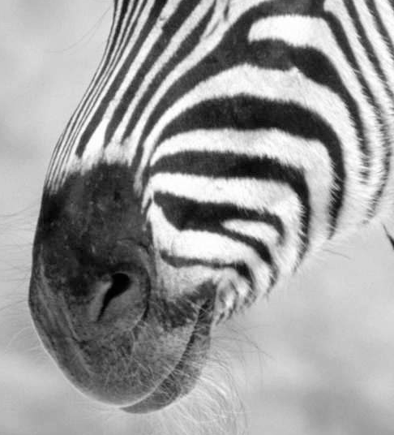
Subsampling by a factor of 2
Throw away every other row and column to create a 1/2 size image

Slide 6
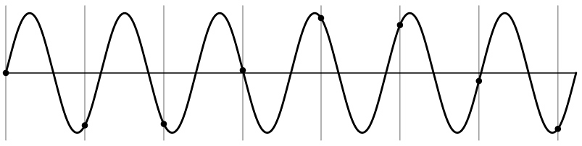
Aliasing problem
1D example (sinewave):
Source: S. Marschner

Slide 7
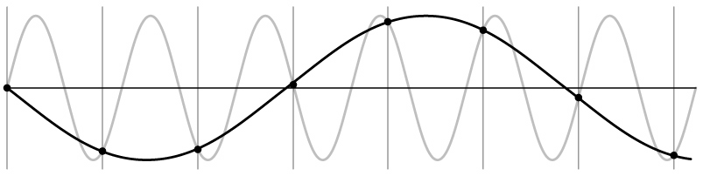
Aliasing problem
1D example (sinewave):
Source: S. Marschner

Slide 8
Aliasing problem
Sub-sampling may be dangerous….
Characteristic errors may appear:
“car wheels rolling the wrong way in movies”
“Checkerboards disintegrate in ray tracing”
“Striped shirts look funny on color television”
Source: D. Forsyth

Slide 9
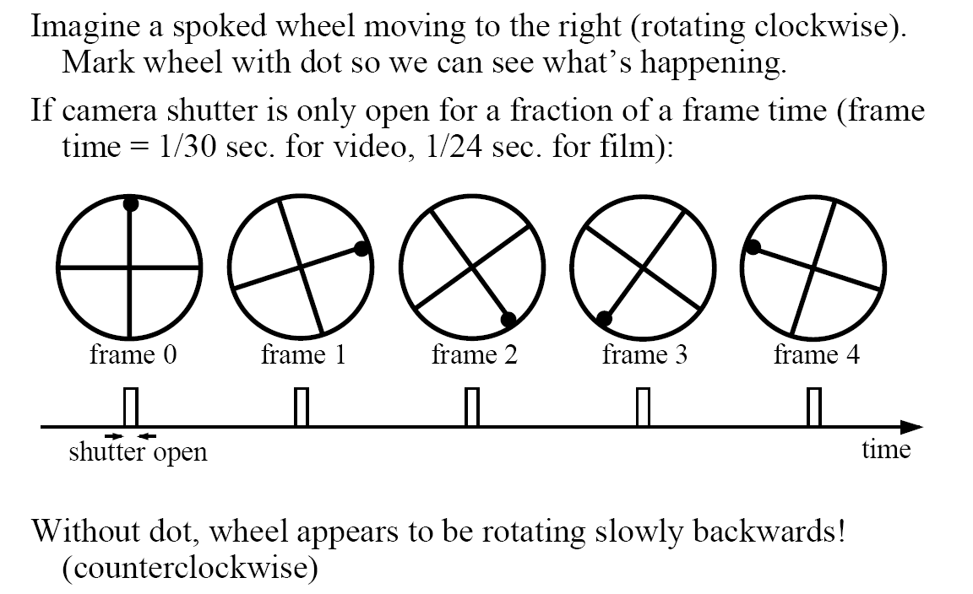
Aliasing in video
Slide by Steve Seitz

Slide 10
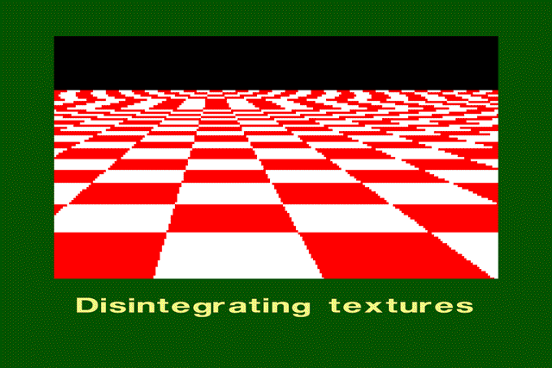
Aliasing in graphics
Source: A. Efros

Slide 11
Sampling and aliasing

Slide 12
Nyquist-Shannon Sampling Theorem
When sampling a signal at discrete intervals, the sampling frequency must be ≥ 2 × f_{max}
f_{max} = max frequency of the input signal
This will allows to reconstruct the original perfectly from the sampled version
v
v
v
good
bad

Slide 13
Anti-aliasing
Solutions:
Sample more often
Get rid of all frequencies that are greater than half the new sampling frequency
Will lose information
But it’s better than aliasing
Apply a smoothing filter

Slide 14
Algorithm for downsampling by factor of 2
Start with image(h, w)
Apply low-pass filter
im_blur = imfilter(image, fspecial(‘gaussian’, 7, 1))
Filtering assures to maintain the most important components before getting rid of every other pixel. Review the examples in the following slides to observe the differences between downsampling with or without pre-filtering
Sample every other pixel
im_small = im_blur(1:2:end, 1:2:end);

Slide 15
Anti-aliasing
Forsyth and Ponce 2002

Slide 16
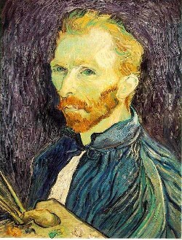
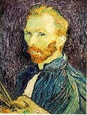

Subsampling without pre-filtering
1/2
1/4 (2x zoom)
1/8 (4x zoom)
Slide by Steve Seitz

Slide 17



Subsampling with Gaussian pre-filtering
Gaussian 1/2
G 1/4
G 1/8
Slide by Steve Seitz

Slide 18
Sampling – Lab1
Run the example in SamplingDemo_Incomplete.m
This given code implements downsampling with factor (0.5) without pre-filtering
Modify the code to apply Upsampling with a factor of two on the original input image. Then use the (imshow) function to display the input (before and after) to illustrate the differences between the downsampling output and the upsampling output
Hints:
Learn how to use the function (imresize) for up or down sampling

Slide 19
Sampling – Lab2
Use the function imresize to downsample input images in order to create the following output image in an exact output size of (720x820) pixel or the closest possible estimated size
820 pixel
Cat
Bird
720 pixel
Fish
Dog

Slide 20
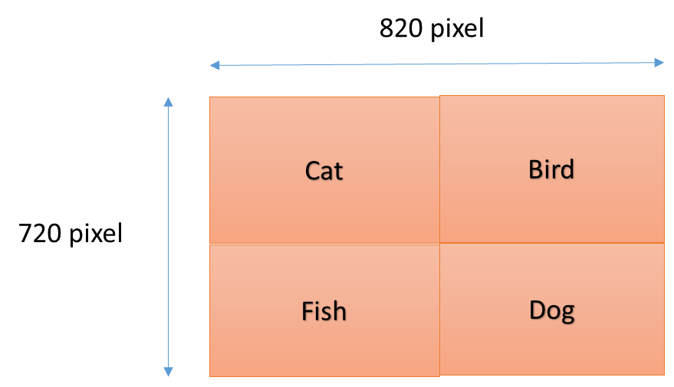
Sampling – Lab3 (to be continued as an assignment)
Repeat the down-sampling step (originally given in the code) using the following interpolation techniques (all available as different options for the same Matlab function)
Nearest Neighbor
Bilinear
Bicubic
Then display each down-sampling output and compare between the different outputs, comment on the quality of the down sampled images obtained with different methods.
Use FFT to convert the output of each technique to the frequency domain then display the results in the frequency domain. Can you provide any conclusion on which technique resulted into more impact on the frequency domain of the image?
HINT: choose a specific LP filter and HP filter, then apply them on each case, in order to construct your comparison

Slide 21
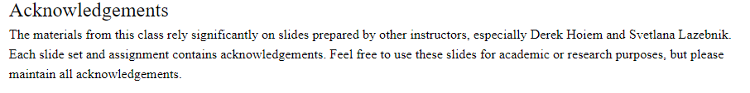
References, Credits, & Aknowledgments
All slides & most of the initial code is modified version from the original computer vision focused course available at: https://www.cc.gatech.edu/~hays/compvision/
Original Acknowledgements
On Separability , http://www.songho.ca/dsp/convolution/convolution.html#convolution_2d

Slide 22
Edge / Boundary Detection
Szeliski 4.2
Computer Vision
James Hays
Many slides from Lana Lazebnik, Steve Seitz, David Forsyth, David Lowe, Fei-Fei Li, and Derek Hoiem

Slide 23
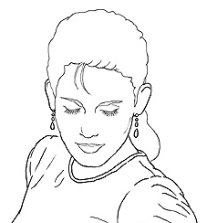
Edge detection
Goal: Identify sudden changes (discontinuities) in an image
Intuitively, most semantic and shape information from the image can be encoded in the edges
More compact than pixels
Ideal: artist’s line drawing (but artist is also using object-level knowledge)
Source: D. Lowe

Slide 24
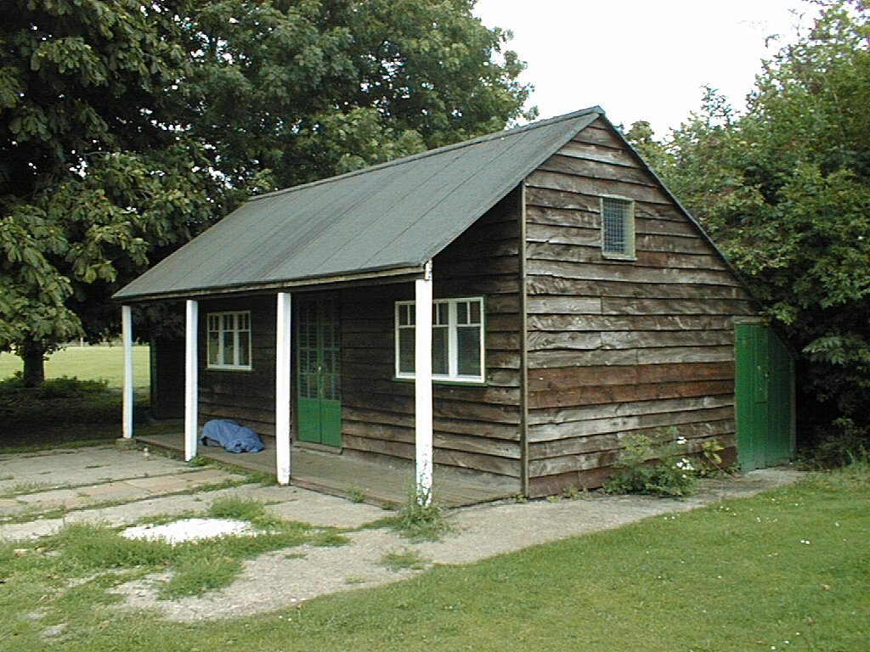
Why do we care about edges?
Extract information, recognize objects
Recover geometry and viewpoint
Vertical vanishing
point
(at infinity)
Vanishing
line
Vanishing
point
Vanishing
point

Slide 25
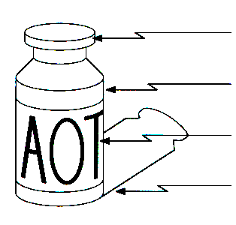
Origin of Edges
surface normal discontinuity
depth discontinuity
surface color discontinuity
illumination discontinuity
Edges are caused by a variety of factors
Source: Steve Seitz

Slide 26
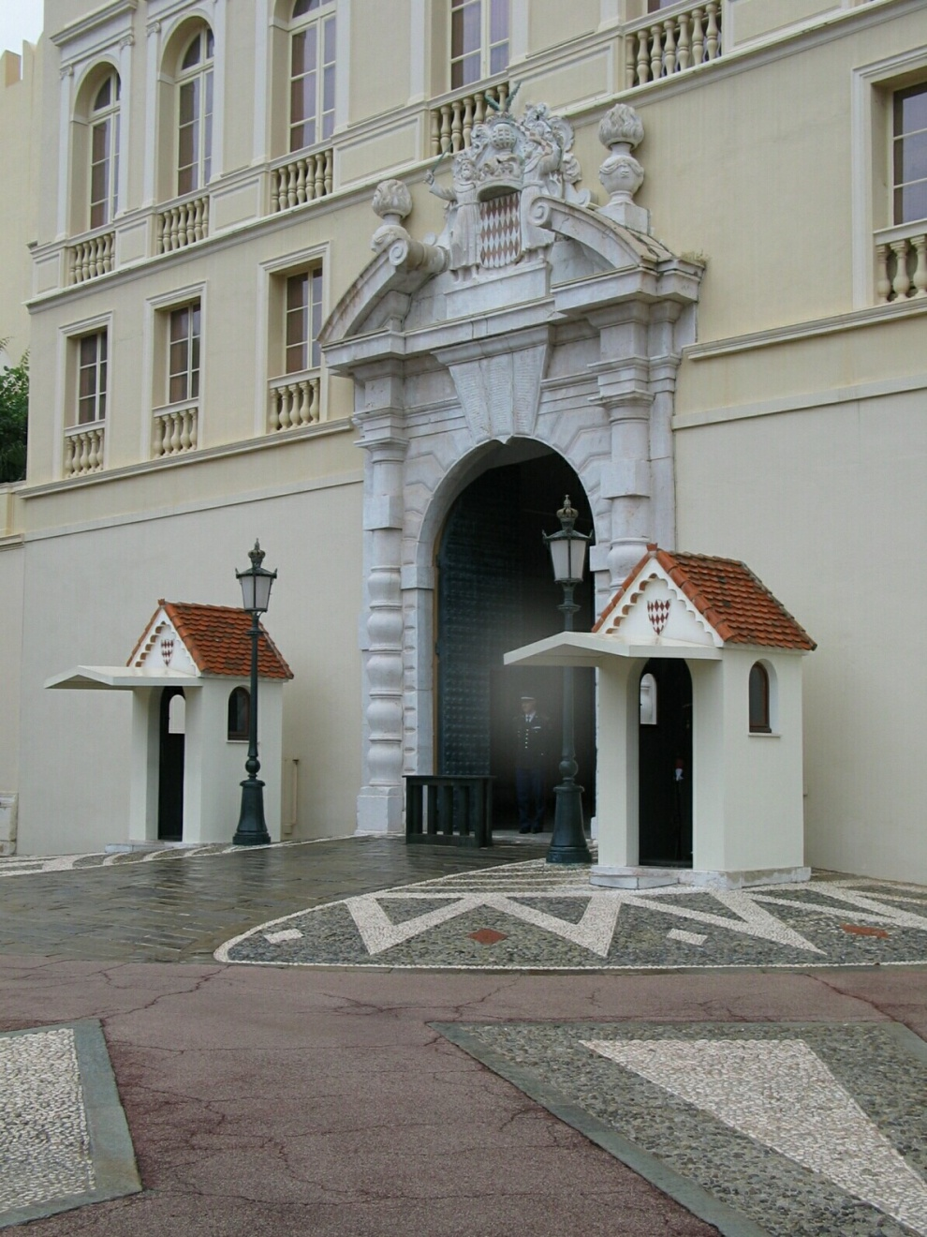
Closeup of edges
Source: D. Hoiem

Slide 27
Closeup of edges
Source: D. Hoiem

Slide 28
Closeup of edges
Source: D. Hoiem

Slide 29
Closeup of edges
Source: D. Hoiem

Slide 30

Characterizing edges
An edge is a place of rapid change in the image intensity function
intensity function (along horizontal scanline)
image
first derivative
edges correspond to extrema of derivative

Slide 31
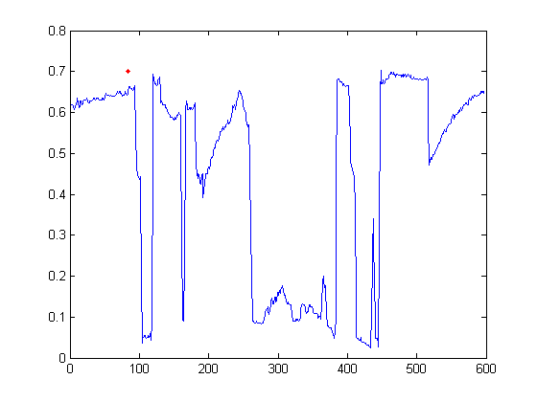

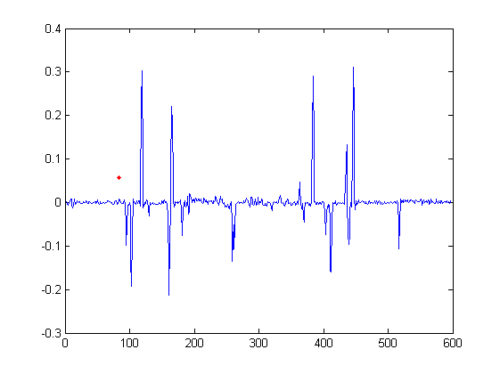
Intensity profile
Source: D. Hoiem

Slide 32
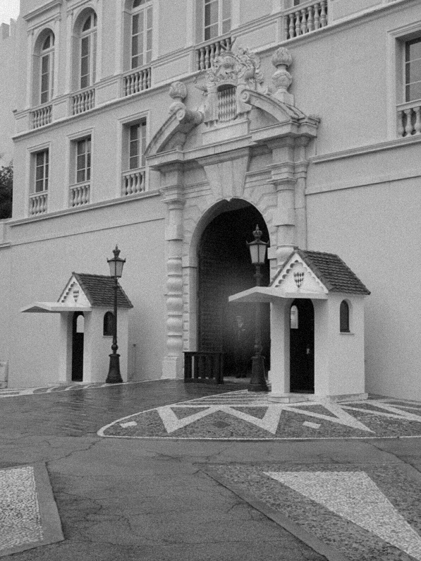
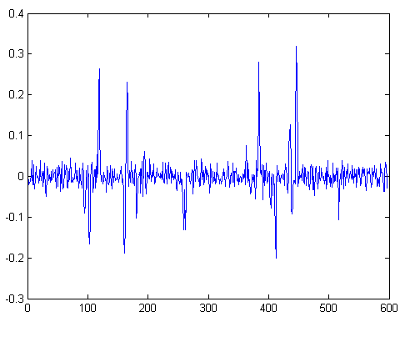
With a little Gaussian noise
Gradient
Source: D. Hoiem

Slide 33
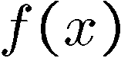
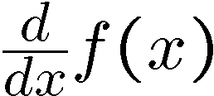
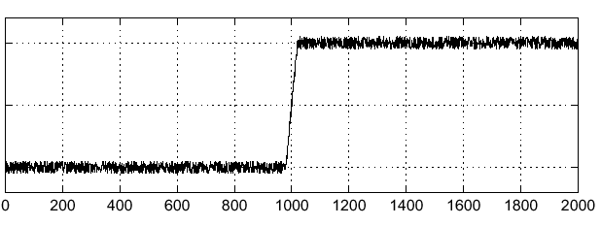
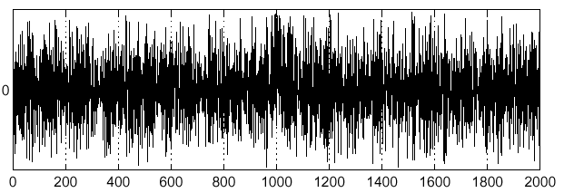
Effects of noise
Consider a single row or column of the image
Plotting intensity as a function of position gives a signal
Where is the edge?
Source: S. Seitz
Notes:
How to fix?

Slide 34
Effects of noise
Difference filters respond strongly to noise
Image noise results in pixels that look very different from their neighbors
Generally, the larger the noise the stronger the response
What can we do about it?
Source: D. Forsyth

Slide 35
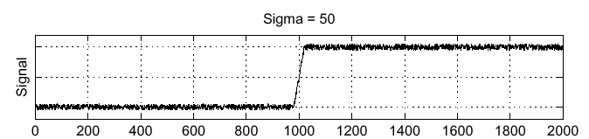
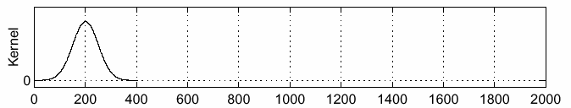
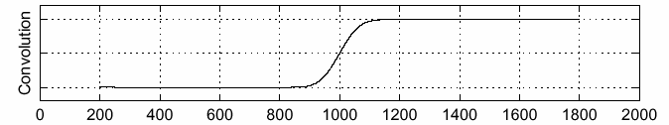
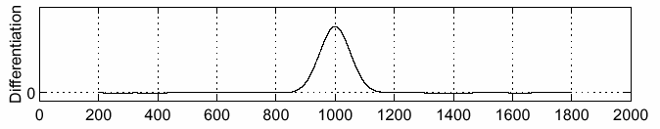
Solution: smooth first
f
g
f * g
To find edges, look for peaks in
Source: S. Seitz

Slide 36
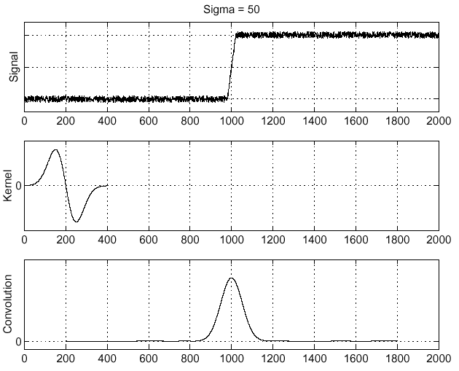
Derivative theorem of convolution
Differentiation is convolution, and convolution is associative:
This saves us one operation:
f
Source: S. Seitz

Slide 37
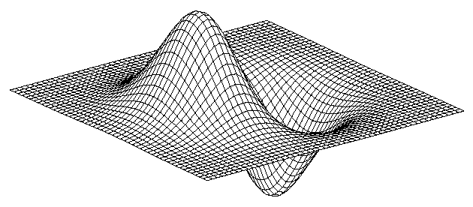
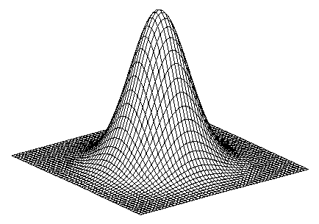
Derivative of Gaussian filter
* [1 -1] =
Notes:
Is this filter separable?

Slide 38
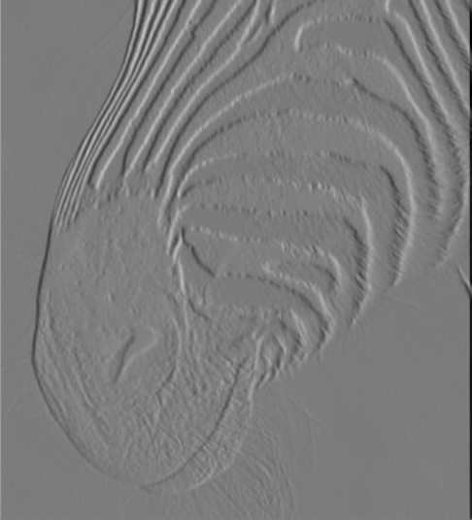
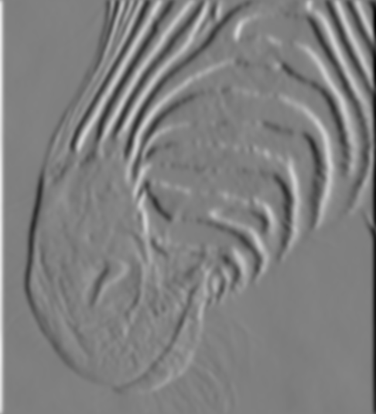
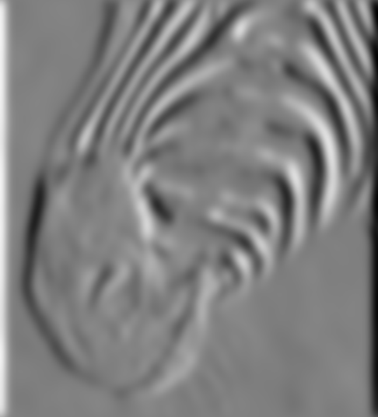
Tradeoff between smoothing and localization
1 pixel
3 pixels
7 pixels
Smoothed derivative removes noise, but blurs edge. Also finds edges at different “scales”.
Source: D. Forsyth

Slide 39
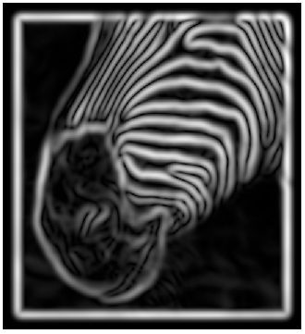
Implementation issues
The gradient magnitude is large along a thick “trail” or “ridge,” so how do we identify the actual edge points?
How do we link the edge points to form curves?
Source: D. Forsyth
Notes:
Figures show gradient magnitude of zebra at two different scales

Slide 40
Designing an edge detector
Criteria for a good edge detector:
Good detection: the optimal detector should find all real edges, ignoring noise or other artifacts
Good localization
the edges detected must be as close as possible to the true edges
the detector must return one point only for each true edge point
Cues of edge detection
Differences in color, intensity, or texture across the boundary
Continuity and closure
High-level knowledge
Source: L. Fei-Fei

Slide 41
Canny edge detector
This is probably the most widely used edge detector in computer vision
Theoretical model: step-edges corrupted by additive Gaussian noise
Canny has shown that the first derivative of the Gaussian closely approximates the operator that optimizes the product of signal-to-noise ratio and localization
J. Canny, A Computational Approach To Edge Detection, IEEE Trans. Pattern Analysis and Machine Intelligence, 8:679-714, 1986.
27,000 citations!
Source: L. Fei-Fei

Slide 42
Note about Matlab’s Canny detector
Small errors in implementation
Gaussian function not properly normalized
First filters with a Gaussian, then a difference of Gaussian (equivalent to filtering with a larger Gaussian and taking difference)

Slide 43

Example
original image (Lena)

Slide 44
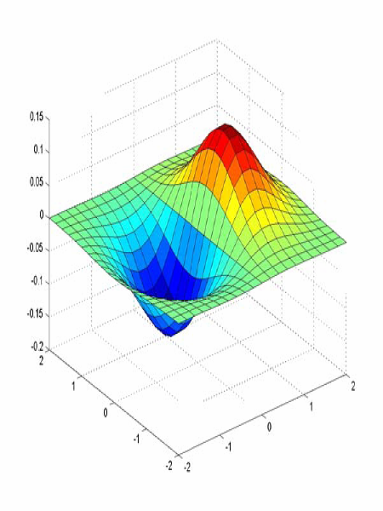
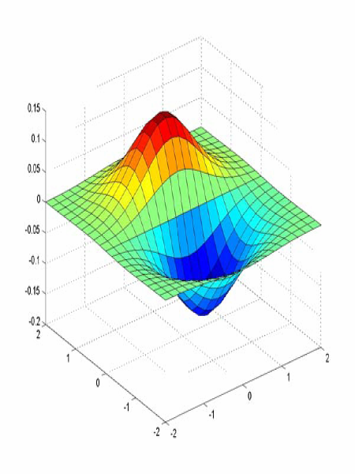
Derivative of Gaussian filter
x-direction
y-direction

Slide 45
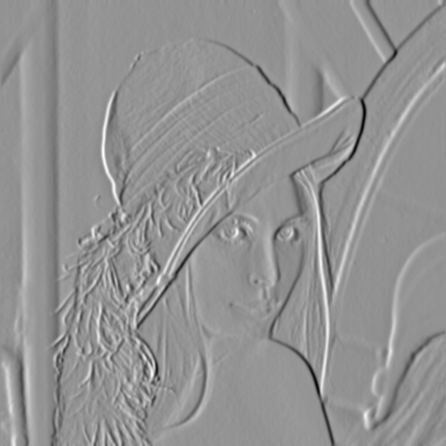
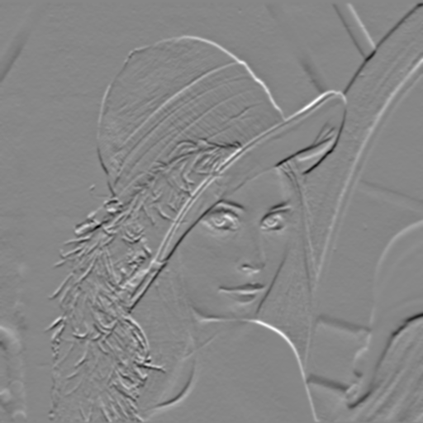
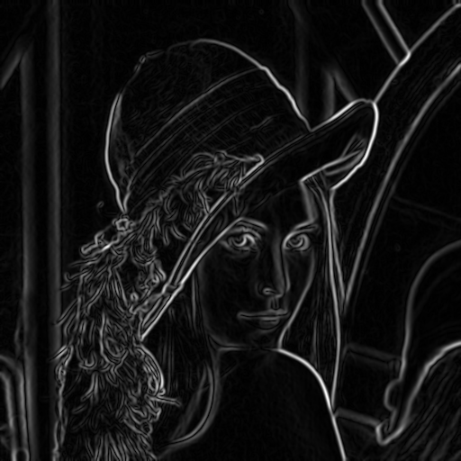
Compute Gradients (DoG)
X-Derivative of Gaussian
Y-Derivative of Gaussian
Gradient Magnitude

Slide 46
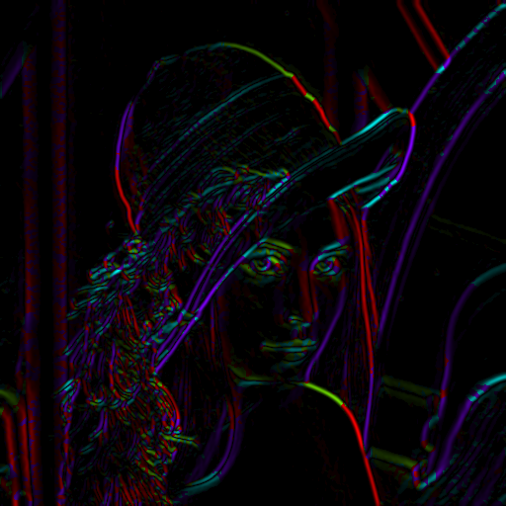
Get Orientation at Each Pixel
Threshold at minimum level
Get orientation
theta = atan2(gy, gx)

Slide 47
Lab 4
Choose an input image
Apply Upsampling (X2) using three different techniques
Apply Canny Edge Detector to the upsampled outputs
Comment on the differences in detecting edges with respect to each up-sampling method
Hint:
Matlab implements canny edge using
edge(yourinput, ‘canny’)

Slide 48
Prepare for Next Week
Search and Read about Morphological Operations in Image Processing
Available within the online free copies of the course recommended references

Slide 49
References, Credits, & Aknowledgments
All slides & most of the initial code is modified version from the original computer vision focused course available at: https://www.cc.gatech.edu/~hays/compvision/
Original Acknowledgements
On Separability , http://www.songho.ca/dsp/convolution/convolution.html#convolution_2d

